Slide 1
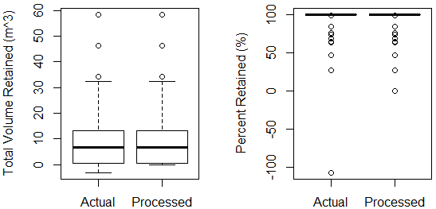
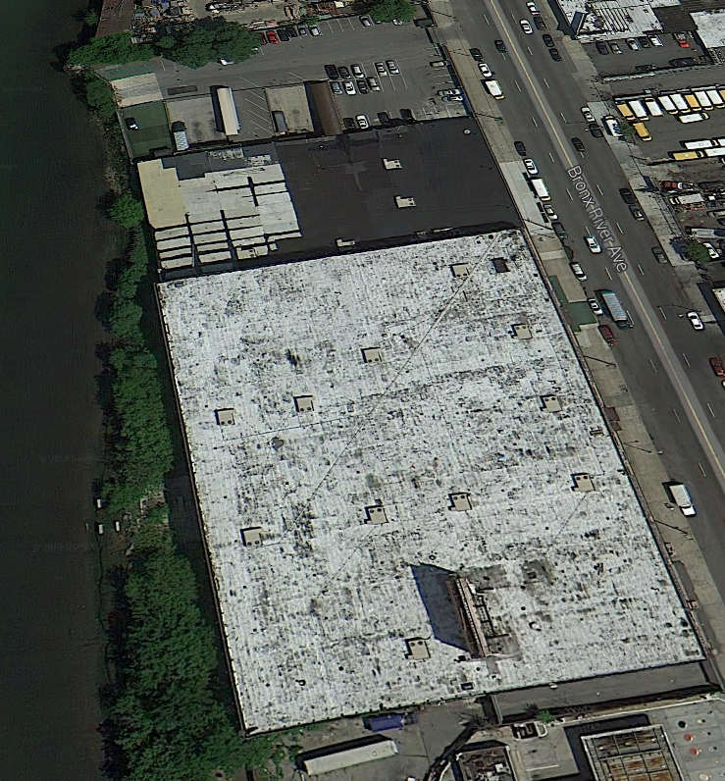
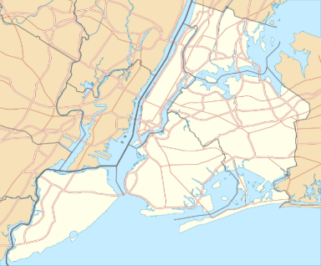
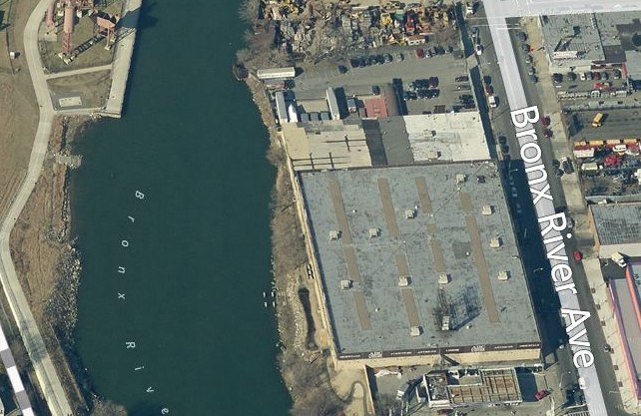
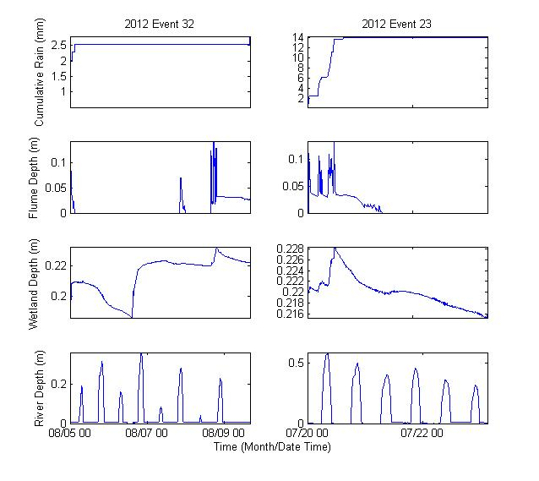
Green Infrastructure: Hydraulic Performance Analysis of the ABC Carpet Stormwater Treatment Wetland installed in the Bronx, NY
Ge Pu | Dr. Franco Montalto | Drexel Sustainable Water Resource Lab
Introduction
Results
Discussion
The ABC Carpet constructed wetland (CW) was built to reduce stormwater runoff from near by parking lot into the Bronx River. It is located at the river bank and behind the carpet warehouse. Prior to wetland construction, the parking lot discharge runoff directly into river, and the river bank was filled with debris. Upon the creation of CW, parking lot runoff was redirected into the wetland, from which only excess overflow flows into river though a riser structure. The river bank was cleaned and plants are now blooming inside the wetland.
This study produced results of 1) spells duration statistics 2) a correlation between cumulative inflow and duration of wet spell 3) a correlation between duration of dry spell and its corresponding water loss 4) a threshold volume (20 m³) of inflow , above which the wetland overflowed into river (with only two exceptions.)
Wet and Dry Spells Duration Statistics (61 events)
 | Wet Spells (hr) | Dry Spells (hr)
Average | 2.77 | 2.83
Maximum | 16.83 | 436.8 (18.2 Days)
Minimum | 0.083 | 4.08
Before
After
On average, 93% of cumulative event inflow (9.88m^3) into wetland was retained, and 9.88m^3 of inflow was reduced. Only 11 out of 61 dry spell events had overflow into river, the other 50 events show 100% inflow retention.
Bronx River Ave
River backflow into wetland occurred occasionally during the study. It is the suspected cause of differences between wetland cumulative outflow and inflow. This phenomenon caused more outflow than inflow during outlier Event #32, and prevented outflow into the river during outlier Event 23.
Parking lot stormwater source area
Bronx River
Bronx River
Stormwater wetland
Methods
1:1 ratio
Various hydrologic and hydraulic analyses were performed to investigate the performance of this wetland. Following is a list of methods utilized in this study:
Event Analysis statistically analyze the wet and dry spell durations, as well as the depth of rainfall during the wet events.
Inflow Volume vs. Rainfall Depth assesses the relationship between total inflow volume of water into the wetland (including direct rainfall), and the precipitation amount.
Dry Spell Water Loss vs. Duration assesses the relationship between the duration, and total volume of water lost, during dry spells.
Overflow into River vs. Inflow Volume establishes a relationship between the volume of outflow into river during one dry spell, and the amount of cumulative inflow during the previous wet spell.
Total Volume Retained quantifies how much water was retained (either through evapotranspiration or plant uptake) during one set of wet and dry spells.
Percentage of Volume Retained determines the percentage of one wet event that was retained in the CW during the wet spell and subsequent dry spell.
Future Work
SWMM Model in progress
Validate with existing site conditions
Compare site pre-development, development and greened conditions
Incorporate tidal effects at the outlet
Simulate results under various rainfall event
Compare site Hydraulic Performance with NYC Green Infrastructure standards, and economic cost-effectiveness
1:1 ratio
Monitoring Team Partners

