Slide 1
Investigation of the Environmental Risk Assessment of Sitagliptin
M. Buzby; J. Tell; L. Ziv; G. Gagliano
Merck & Co., Inc., Whitehouse Station, NJ
Philadelphia Section of the
American Water Resources Association
October 17, 2013

Slide 2
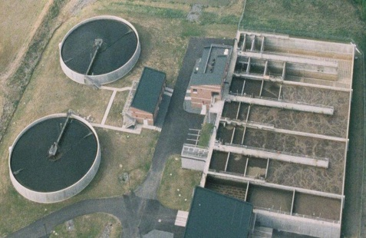


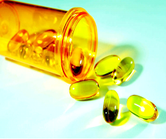
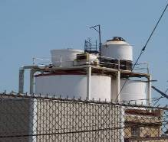
Pathways to the Environment
Primary Pathway
Wastewater Treatment
Unused medicines
(Minor pathway)
Manufacturing
(Minor pathway)

Slide 3
Elements of An Environmental Risk Assessment
Hazard Identification
Fate
Exposure
Risk = f (hazard, exposure)
Effects
Risk Characterization
Risk Management

Slide 4
Elements of the Environmental Risk Assessment
Patient excretion to wastewater
Wastewater treatment plant
Discharge of wastewater to freshwater and marine environment
Effects / Toxicity
Exposure
Fate
Disposal of sludge on land
Aquatic environment
Terrestrial environment
Sediment environment
Groundwater environment

Slide 5
Environmental Risk Assessments
of Human Pharmaceuticals
Environmental fate and effects testing is currently being done during the drug registration process to help address these questions
Required component of drug marketing applications
  Efficacy, Safety, Quality
The recent European Union Guideline (December 2006) requires extensive testing in order to prepare an environmental risk assessment
  Persistence, Bioaccumulation, Toxicity (PBTs)
  Testing requirements are significant: 1½ – 2½ years of testing

Slide 6
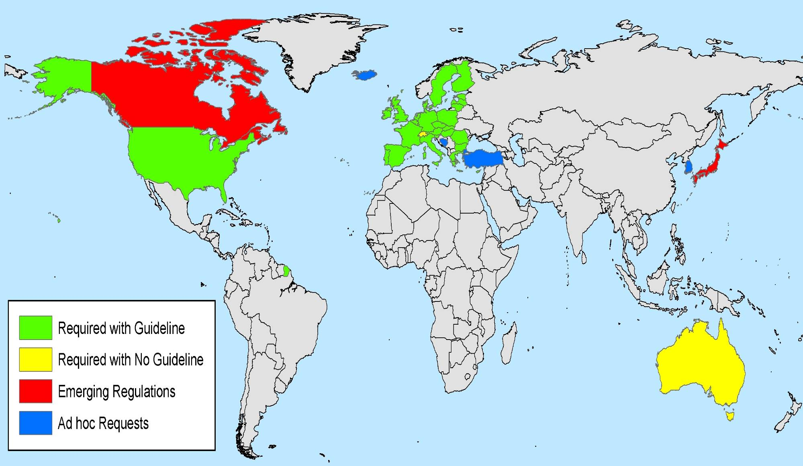
Global Regulatory Picture

Slide 7
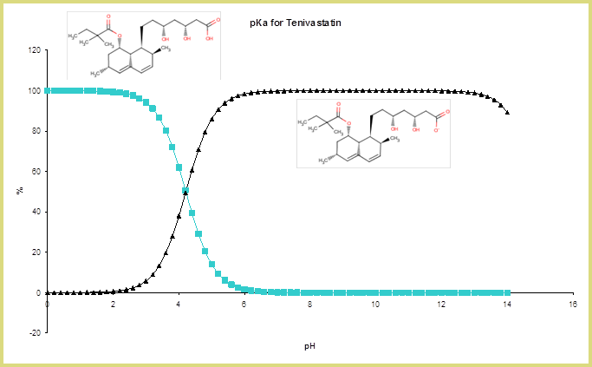
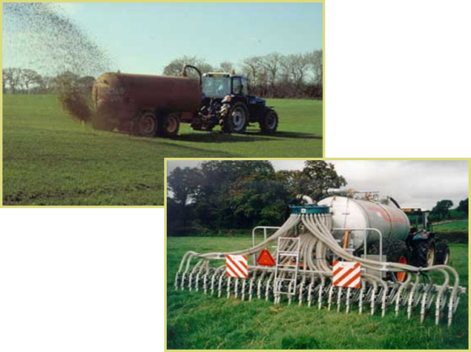

Fate in the Environment
Acid dissociation constant (pKa)
octanol
water
Adsorption - desorption to
sewage sludge (Koc)
Octanol/water
partition coefficient (Kow)
Hydrolysis
Photolysis

Slide 8

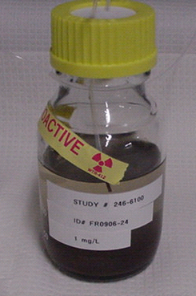
Fate in the Environment
Fate in the Environment
Biodegradation by sewage sludge
microorganisms
Source: www.bam.gov
Transformation in aquatic sediments/soils
Binding to aquatic sediments/soils
Source: Springborn Smithers Laboratories

Slide 9
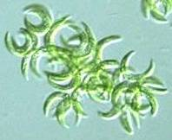
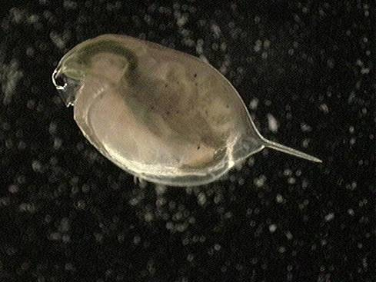
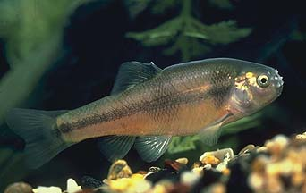
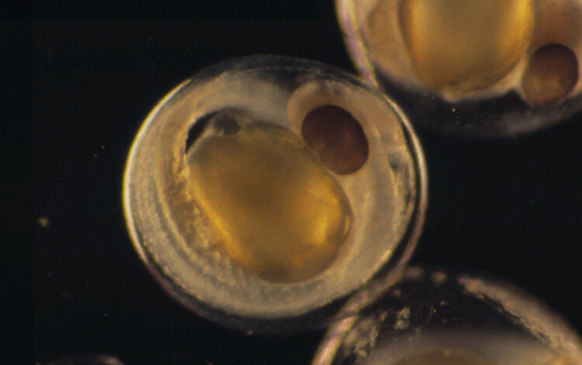
Aquatic Toxicity
Algae Growth Inhibition
Invertebrate Reproduction
Source: Springborn Smithers Laboratories
Effects on Early Life Stage of Fish

Slide 10
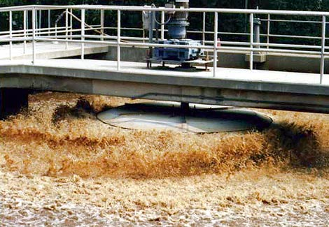
Activated Sludge Respiration Inhibition Test (ASRIT)

Slide 11
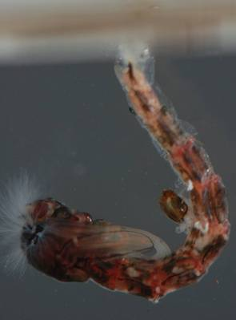
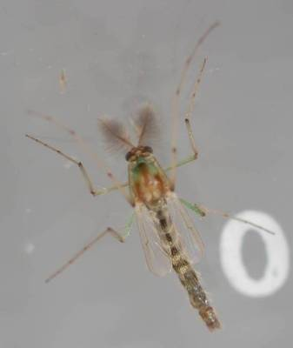
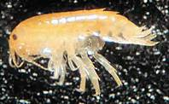
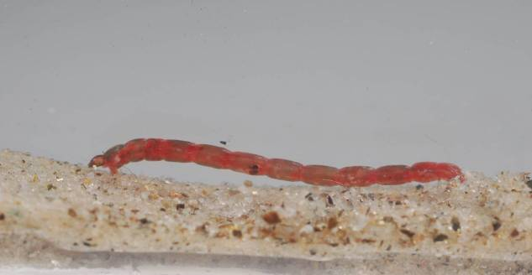

Sediment Toxicity
If binding to sediments > Action Limit
triggers sediment effects testing
Lumbriculus sp.
Hyalella sp.
Chironomus sp.
Source: Springborn Smithers Laboratories
Chironomus sp.

Slide 12
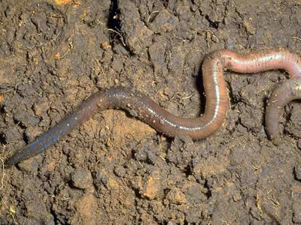
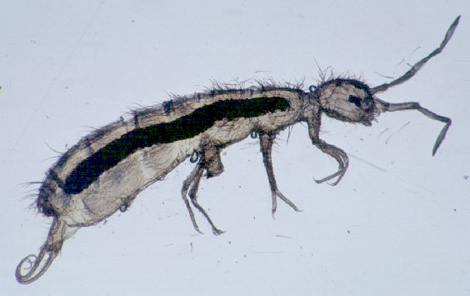
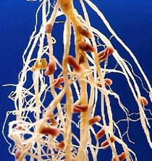
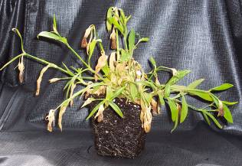
Terrestrial Fate and Effects
If log K_{oc} > Action Limit
triggers terrestrial effects testing
Collembola sp.

Slide 13
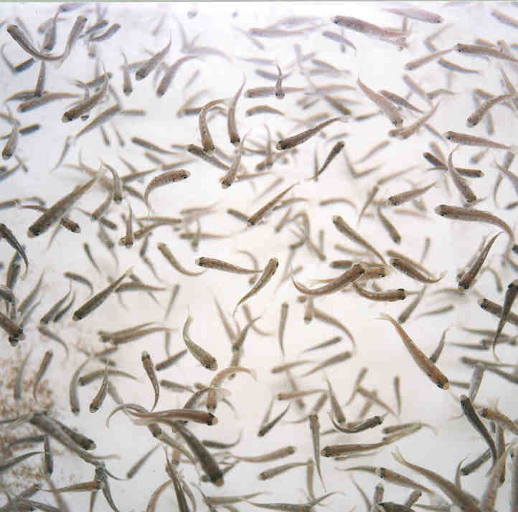
Bioconcentration in Fish
If log K_{ow} > Action Limit
triggers bioaccumulation testing
Source: Springborn Smithers Laboratories

Slide 14
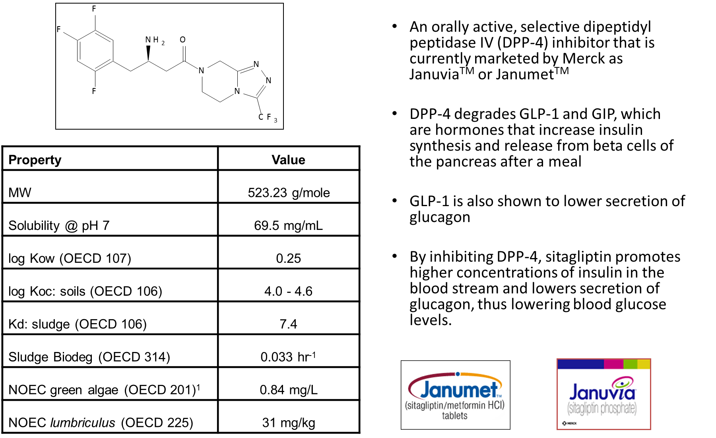
Sitagliptin Profile
1: Most sensitive species. Other chronic aquatic toxicity tests conducted were
the Fish Early Life State and Daphnia Reproduction
Notes:
Sitagliptin is the active pharmaceutical ingredient (API) of Januvia™ (sitagliptin) and Janumet™ (sitagliptin + metformin) for the treatment of Type II diabetes. Previous work has been presented on a prospective risk assessment for Januvia in the United States, which included the collection of environmental fate and effects data, the assessment of future patient use of sitagliptin based on the rising prevalence of diabetes mellitus, and environmental modeling to predict future concentrations of sitagliptin in surface water and drinking water. This study has been expanded to include updated biodegradation data of sitagliptin, improved fate modeling of sitagliptin in the US and the EU and also includes an environmental risk assessment of metformin, which is the second API in the medicine Janumet™ based on new environmental fate and effects data collected for this widely used generic compound.
Results indicate that predicted environmental concentrations from patient use of both these API are well below any effect levels for aquatic and sediment-dwelling organisms.

Slide 15
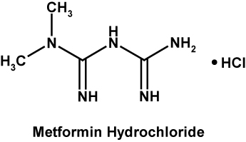

Metformin Profile
Metformin HCl is a biguanide antidiabetic agent currently marketed by Merck in combination with sitagliptin as JanumetTM
It reduces blood glucose concentrations primarily by suppressing hepatic glucose production.
Extrahepatic effects of metformin include increased insulin-stimulated glucose transport, glucose utilization and glycogen synthesis skeletal muscle and glucose oxidation and storage in glycogen and fat.
Metformin also decreases blood glucose concentrations by reducing the rate of absorption of glucose from the intestine.
Property | Value
MW | 165.63 g/mole
Solubility @ pH 7 | 286 g/L
log Kow (OECD 107) | < -2
log Koc: soils (OECD 106) | 1.8 – 4.3
Kd: sludge (OECD 106) | 0.90
Sludge Biodeg (OECD 314) | 0.34 hr⁻¹
NOEC fathead minnow (OECD 210)¹ | 10 mg/L
NOEC midge (OECD 218) | 62 mg/kg
1: Most sensitive species, no effects seen at highest concentration tested. Other chronic aquatic toxicity tests conducted were the Green Algae and Daphnia Reproduction

Slide 16
Risk Assessment Approach
Obtain Sales Data (kg/yr) from IMS and Merck Supply Chain
Select worst case year
Gathered Data
Phys-Chem
Environmental Fate
Environmental Toxicity
Calculated Predicted Environmental Concentrations (PEC)
PhATE
Great-ER
EMA Defaults
Conduct Literature Review
Compare measured concentrations to modeled
Determine No-Effect Concentrations (NOECs) for aquatic life
Risk Assessment
Compare PECs to NOECs
Sediment Risk Assessment
Based on EU Guidance
(external of models)

Slide 17


GREAT-ER MODEL
A software system that combines a GIS (Geographic Information System) with fate models to produce a simple and clear visualization of predicted chemical concentrations and water quality along a river.
A tool to study the impact of chemicals emitted by point sources into rivers

Slide 18
PhATE TM MODEL
Developed as a risk assessment model by the Pharmaceutical Research and Manufacturers Association (PhRMA) to estimate the potential levels of active pharmaceutical compounds (or ingredients) in water within 11 watersheds of the US
Hydrological inputs rely on the US EPA’s BASINS (Better Assessment Science Integrating Point and Non-point Source) Database
PhATE™ estimates loss due to in-stream mechanisms, water treatment, and biodegradation as surface water flows through streams, into a POTW, undergoes treatment, and then is discharged back into streams
The model provides PECs for both low and high flow conditions for each segment in watersheds
PhATE

Slide 19
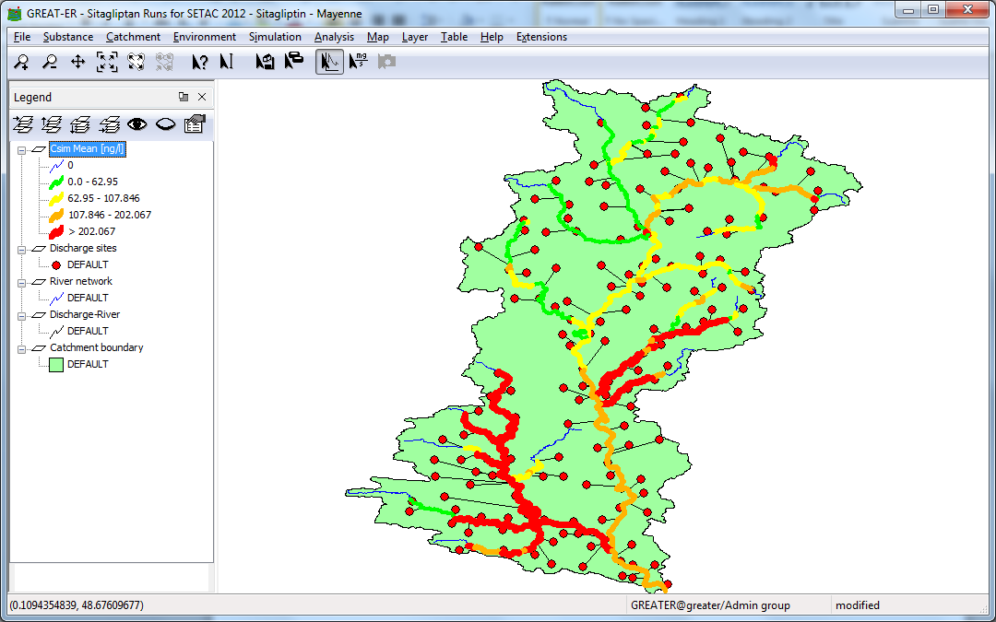
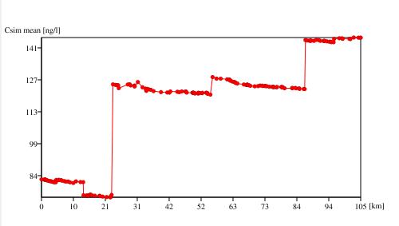
Sitagliptin – GREAT-ER Results
Example Output:
PEC by River Reach and Watershed Maps

Slide 20
Sitagliptin – PhATE Results

Slide 21
Sitagliptin Environmental Risk Assessment
Predicted concentrations were similar for Europe and US
Difference could be attributed to market share
All predicted concentrations were significantly less than NOEC for algae
  Max surface water concentration: 3.4 µg/L
  Lowest NOEC (algae): 840 µg/L
Sediment Compartment
  Max PEC sediment: 3 µg/kg
  Lowest NOEC (lumbriculus): 31000 µg/kg
CONCLUSION: Insignificant Risk to the Environment

Slide 22
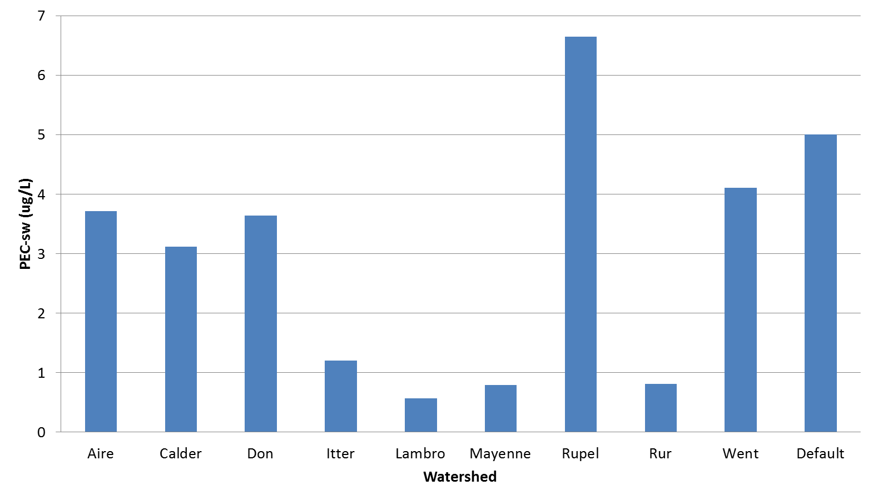
Metformin – GREAT-ER Results

Slide 23
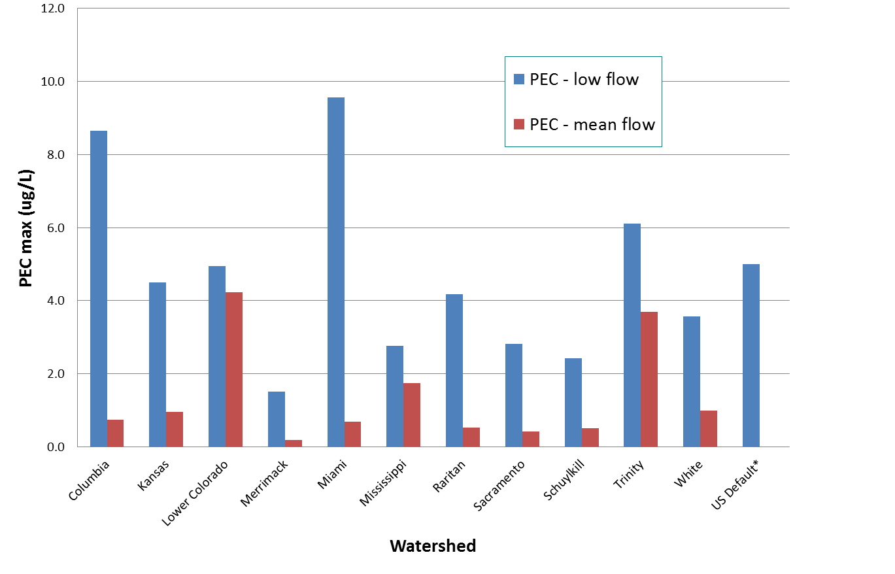
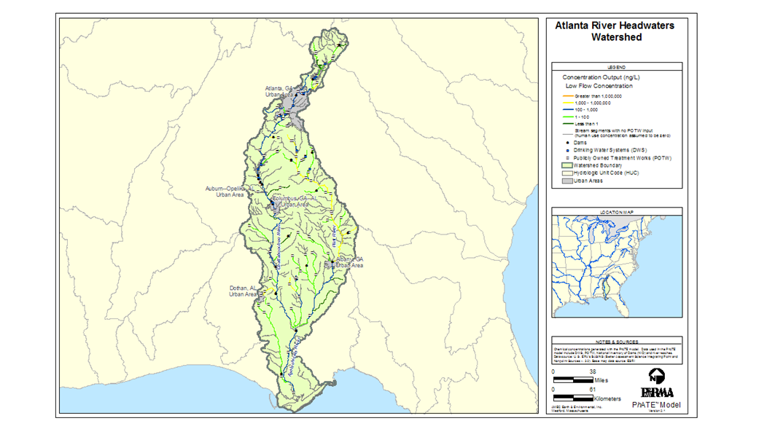
Metformin – PhATE Results

Slide 24
Metformin Environmental Risk Assessment
Predicted concentrations were similar for Europe and US
Measured PECs for metformin taken from the literature were significantly lower (0.1 – 0.15 µg/L)
  Possible reason: Additional degradation occurring not considered in modeling
All predicted concentrations were significantly less than NOEC for fathead minnow
  Max surface water concentration: 10 µg/L
  Lowest NOEC (minnow): 10000 µg/L
Sediment Compartment
  Max PEC sediment: 200 µg/kg
  Lowest NOEC (lumbriculus): 62000 µg/kg
CONCLUSION: Insignificant Risk to the Environment

Slide 25
Conclusion
Extensive environmental fate and effects testing is conducted during the drug registration process using science- based approaches.
The GREAT-ER and PhATE models can be used to predict environmental concentrations of pharmaceutical compounds.
Risk assessments are conducted to comparison the predicted no-effects concentration with predicted environmental concentrations (PEC) to assess the significance of pharmaceuticals in the environment.

